Slide 1
Coffee Shop Data Analysis

Slide 2
Agenda
Profit Margins
Profits per Product Category
Customer Demographics
Customer Segments
Final tips & takeaways

Slide 3
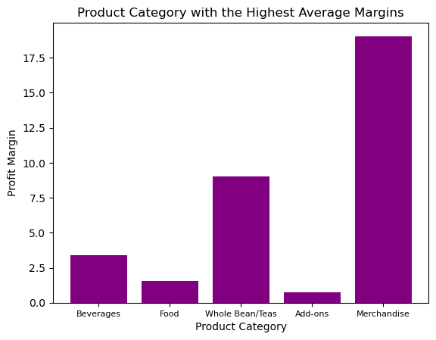
Profit Margins
Considering the products we offer, which categories make the most profit per individual sale?

Slide 4
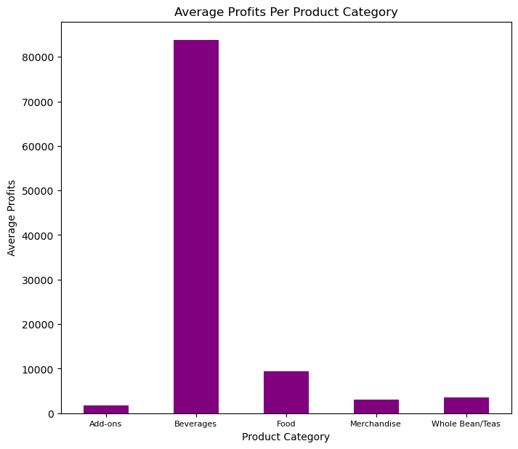
Average Profits
Do most of our profits come from merchandise sales as those products have the highest profit margin?

Slide 5
Which Products are Purchased Most and Least Often?
 | quantity | line_item_id
product
Earl Grey Rg | 1558 | 1017
Dark chocolate Lg | 1546 | 1007
Latte | 1531 | 1007
Morning Sunrise Chai Rg | 1513 | 994
Ethiopia Rg | 1506 | 979
... | ... | ...
Guatemalan Sustainably Grown | 48 | 78
Primo Espresso Roast | 47 | 64
Peppermint | 45 | 91
Spicy Eye Opener Chai | 42 | 71
Dark chocolate | 36 | 56
These are the 5 most and least purchased products.

Slide 6
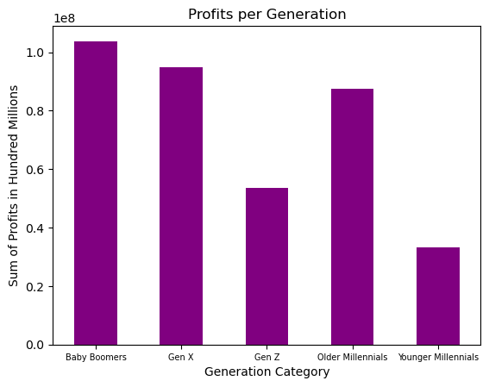
Customer Demographics
Let’s take a look at our customer base to gain an understanding of who we are selling to.
*This is a representation of only our loyalty customers.

Slide 7
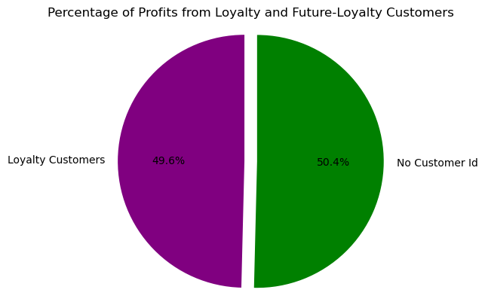
Customer Segments
How do our loyalty membership and future loyalty membership customers stack up against each other?
Next, we’ll look at the profits from each.

Slide 8
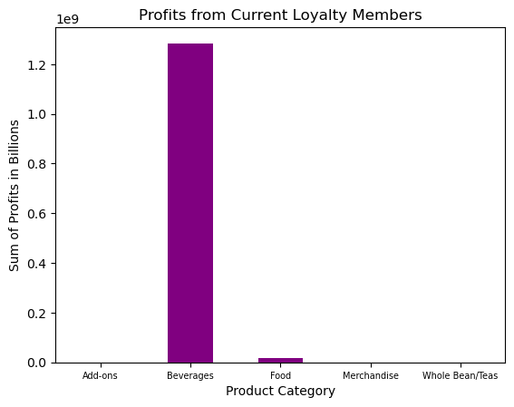
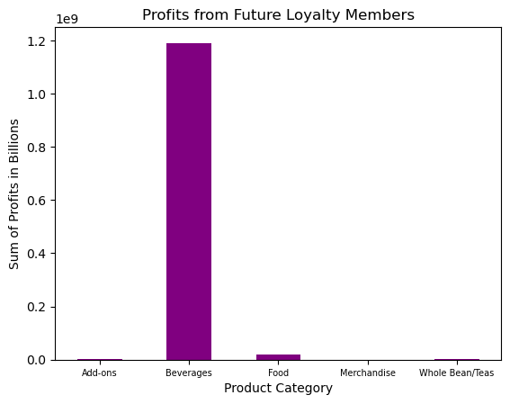
Profits per Loyalty Memberships

Slide 9
The breakdown of Loyalty Program Members by Generational Category:
Baby Boomers: 529
Gen X: 522
Older Millennials: 515
Younger Millennials: 298
Gen Z: 382

Slide 10
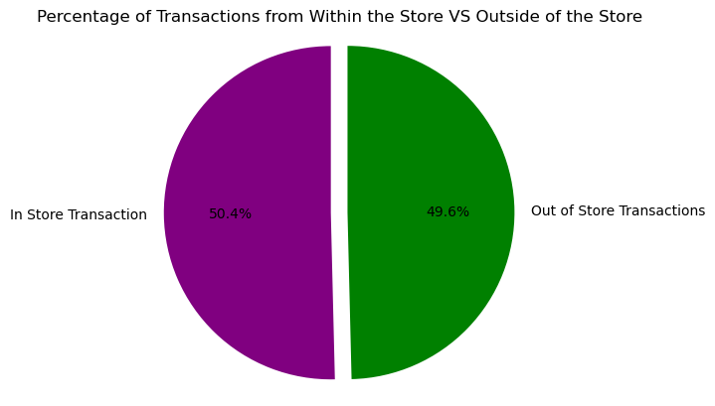
In Store Sales VS Out Of Store
Do we see more sales instore or out-of-store?

Slide 11
Final Thoughts
Due to a minimal amount of variation in customer segments in terms of where profits come from, we should consider customer demographics when designing a marketing strategy.
We could target younger millennial and Gen Z customers and encourage loyalty program participation to ensure continued growth and the continuation of gathering data relating to our customer base.

Slide 12
Thank you
Pamela Berry
DAB 812
General Assembly
Oct 2024

